Slide 1

Building (overseas Building Products, Standards and certification Schemes) Amendment Bill
Presentation to Transport and Infrastructure Select Committee
21 November 2022

Slide 2
Aluminium Extruders of New Zealand Inc do not support the Bill in its current form.
We recommend to:
1. Shift the focus from products to building systems providing clarity and certainty for those designing, building and owning buildings.
2. Provide certainty for consumers by ensuring all imported products are tested by independent test facilities here in New Zealand.
3. Introduce a carbon border adjustment to ensure New Zealand is able to meet its carbon targets and provide a level playing field for New Zealand manufacturers.

Slide 3
Not all products and Standards are created equal
Aluminium alloys commonly used in building / construction, transport and marine application are silicone and manganese alloys.
Commonly 6005, 6060, 6061, 6063, 6082, 6261.
The chemical properties (Si, Mg) of these alloys provide strength (ultimate strength / yield strength), corrosion, weldability, machinability and acceptance of coatings.
The degree of tempering of these alloys (T4, T5, T6) delivers additional strength / elongation.

Slide 4
Recent complaint
Importer advertised product as 6061, being available ex store in NZ.
The customer ordered 6061.
Two of the three sizes delivered were 6063.
Incidentally, the customer requested test certs for the products when they placed their order. Test certs were provided ... but were for 6005.
Strangely the test certs were dated the day the order was placed.... even though the product had to have manufactured months earlier.

Slide 5
Focus on product standards is inadequate
Our buildings are made up of building systems.
Building Systems need to comply with Code Clauses
Façade in picture is complex and
needs to comply with
B1 Structure B2 Durability C1-6 Fire
E2 External moisture E3 Internal Moisture G4 Ventilation
G5 Interior Environment G6 Acoustics G7 Daylight
F- Safety H1 Energy Efficiency
Citing of overseas standards
needs to be at a building system
level. For example
Eurocode 9:2023 Aluminium Structures
Clyde Quay

Slide 6
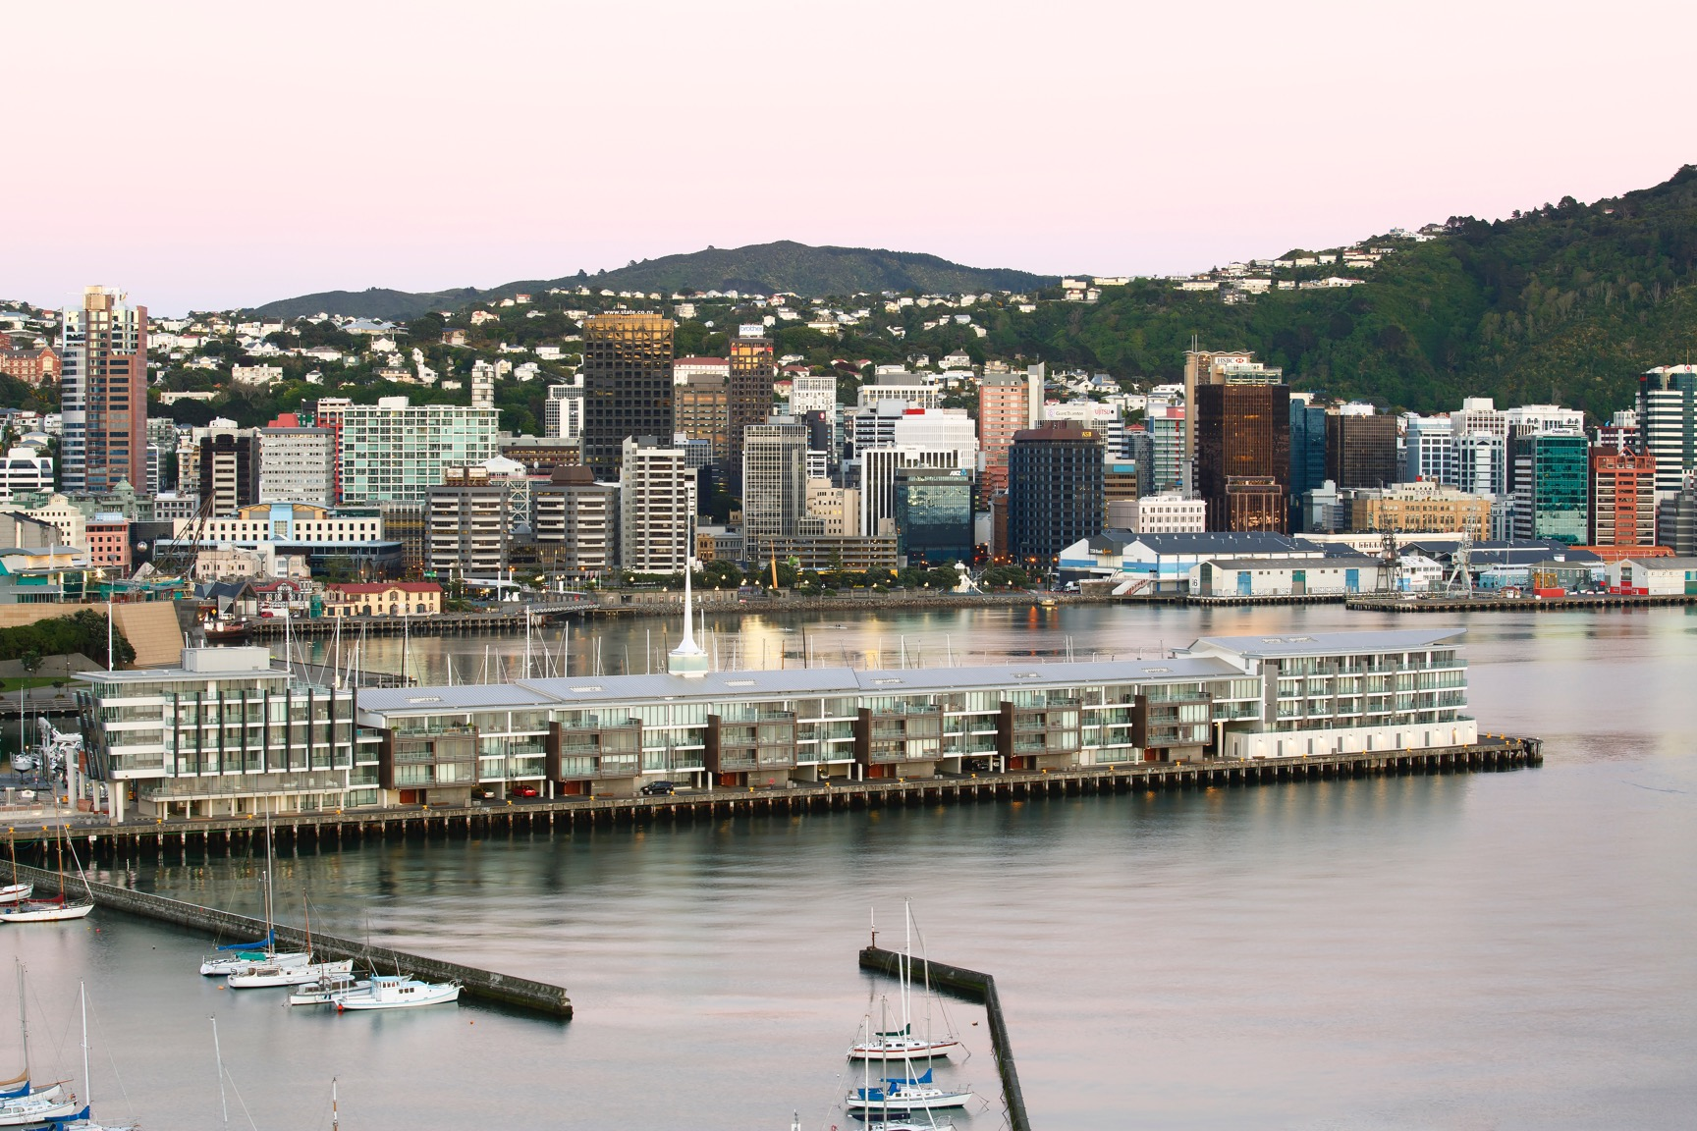

Slide 7
Bill must provide certainty for customers/home owners
Bill needs to include requirement for independent testing of imported building systems here in New Zealand.
  Frequently importers performance claims aren’t substantiated by independent testing.
  Test certificates provided by importers of window systems don’t always align with specific Building Code Clauses.
  Importers fraudulently using BRANZ appraisals owned / paid for by New Zealand company.
Only way to protect home owners is to require imported building systems to be tested by independent testing facilities in New Zealand.

Slide 8
Bill needs to introduce Carbon Border Adjustment
The Built Environment is estimated to account for 20% of New Zealand emissions.
The majority of aluminium billet extruded in New Zealand is sourced from the Tiwai Point smelter or from recycled aluminium.
As a result New Zealand made extrusions and aluminium structures have a relatively small carbon footprint – approximately 1/5th of imports sourced from fossil fuel powered smelters/manufacturing facilities in Asia, where the vast majority of imports to New Zealand originate.
A Carbon Border adjustment will assist New Zealand in reaching our 2050 targets and will provide an even playing field for local manufacturers.

Slide 9
In conclusion
ALENZ does not support the Bill in its current form.
We recommend to:
1. Shift the focus from products to building systems providing clarity and certainty for those designing, building and owning buildings.
2. Providing certainty for consumers by ensuring all imported products are tested by independent test facilities here in New Zealand.
3. Introduce a carbon border adjustment to ensure New Zealand is able to meet its carbon targets and provide a level playing field for New Zealand manufacturers.

Slide 10




Thanks
Questions
ALENZ members

